Slide 1
User Interface Design

Slide 2
Welcome!
Dr. Jillian Aurisano
Plan for today:
Introduce myself (5 min)
Discuss the course
Introduce usability
Do an activity
Notes:
So welcome to engineering visual interfaces for data science. I'm Dr Aurisano.
Thanks for finding the class on Zoom. Hopefully we will be in person again soon.
If anyone out there is comfortable turning on their cameras, that is lovely- then I feel like I am talking to students, rather than to myself.
Here’s our plan for today:
First I’m going to introduce myself, so you know a bit about me
Then we are going to get to know each other, in Zoom breakout rooms. This will give us a chance to make sure that Zoom breakout rooms work, and we all know how to access them.
Then, I am going to walk through the structure, and plan for the course. I want to make sure everyone knows how the course will work, and what to expect, and also a bit about why the course is designed this way.
Then I am going to introduce the class, and what the class is about. Since this is a new class, and one of just a few classes in human centered computing here at UC, I wanted to give an overview of the topic.
Then I have an introductory activity, which we will do in breakout rooms, and which I think will help motivate the discussion on Wednesday, and getting into the meat of the class.

Slide 3
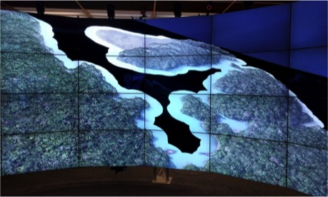
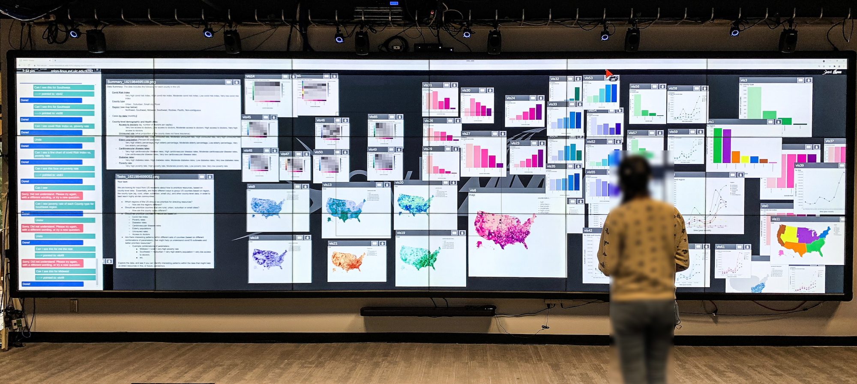
About me
Assistant Professor in Computer Science
Started last fall
My research:
Data visualization
Human computer interaction
‘Beyond the desktop’ environments
Large displays
VR/AR platforms/environments
Interaction other than mouse/keyboard
Notes:
A bit more about me:
I am a new faculty member here at Cincinnati. I finished my PhD this past summer.
I came from Chicago, my MS and PhD is in Computer Science.
I was in a big research lab, that focused on developing visualizations and visualization environments for science and collaboration. And we would put together hardware to build visualization and interaction environments and design visualization applications and software to help scientists understand their data, explore their data and collaborate. It was a really fun place to work and learn and do grad school, so I'm hoping to build similar lab here at UC.
I did my thesis on exploring data through visualizations on a large display using speech and gesture inputs. The bottom image shows one of the participants in a user study I ran interacting with my system.
Before that I did a master's thesis working with scientists on bacterial genomic data- that’s shown at the top
And during grad school, I also worked on other platforms and problems- I worked with ecologists studying animal movement patterns – which is what is shown in the middle
And this research area, and work that I did, started in a visualization class which is similar to this one!

Slide 4
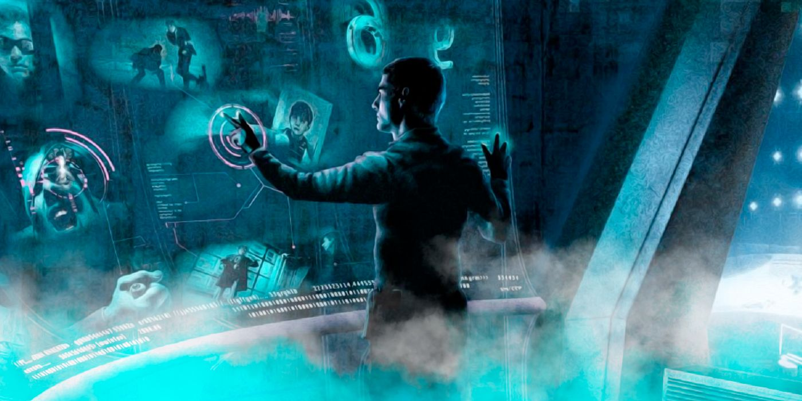
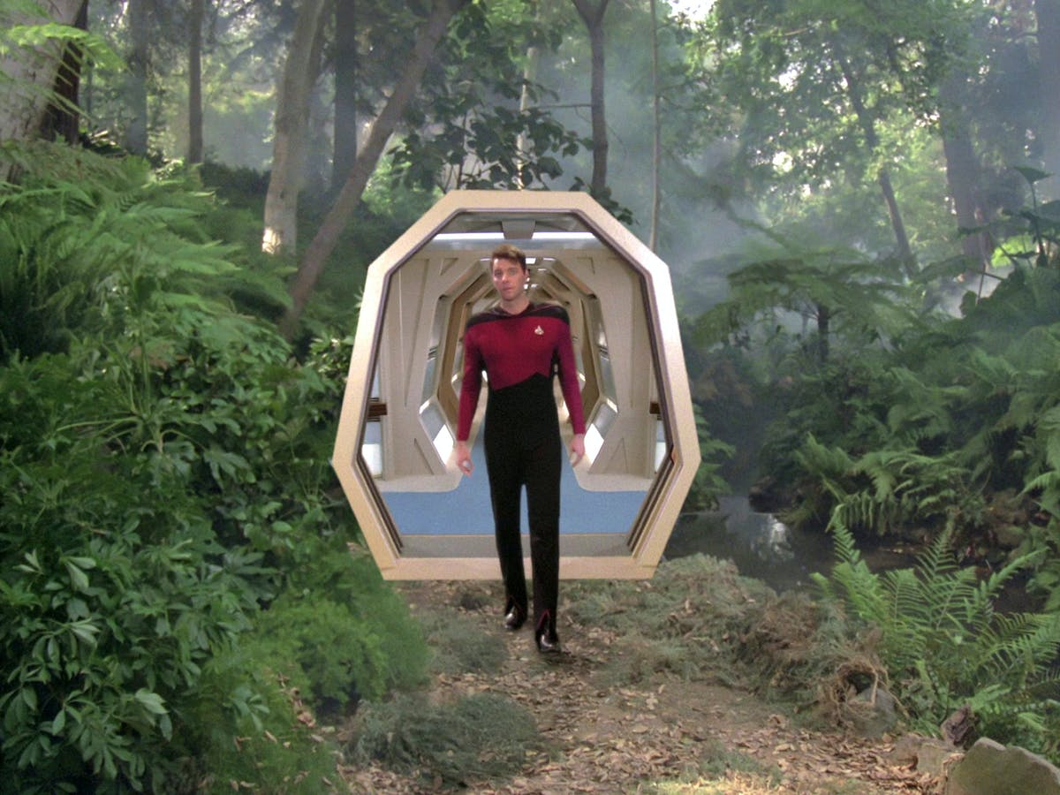
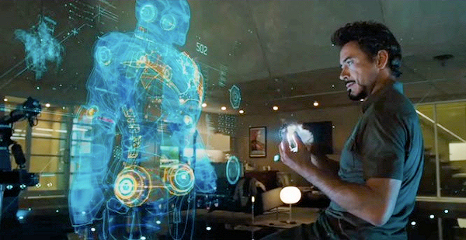
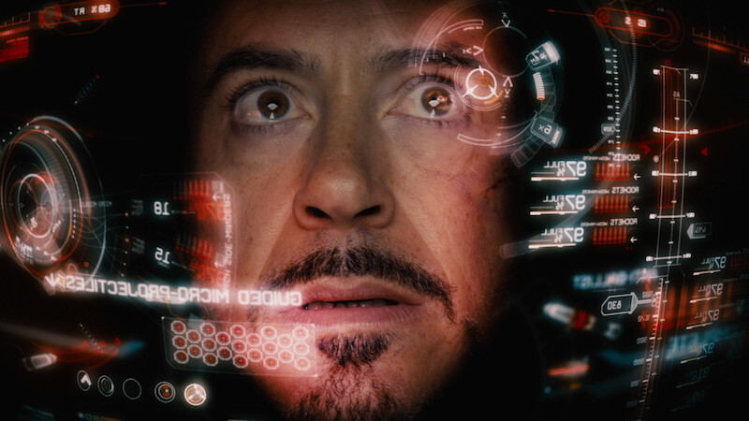
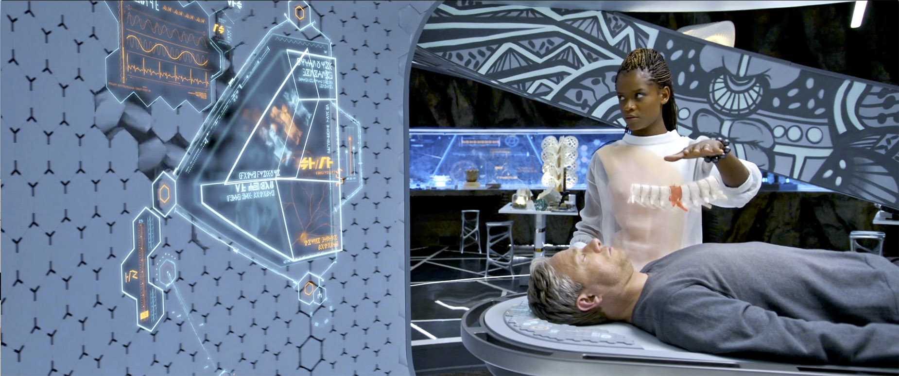
What I like to think my research is ….
Notes:
This is , of course, what I like to think my research is like- and I definitely bill it this way when talking to people. I build big, futuristic interfaces, focusing on helping people understand data

Slide 5
Reality: Still pretty amazing (to me)
I collaborated on this with a team in my lab in grad school

Slide 6
Reality- still pretty amazing (to me)
I collaborated on this with a team in my lab in grad school

Slide 7
Reality: still pretty amazing (to me)

Slide 8
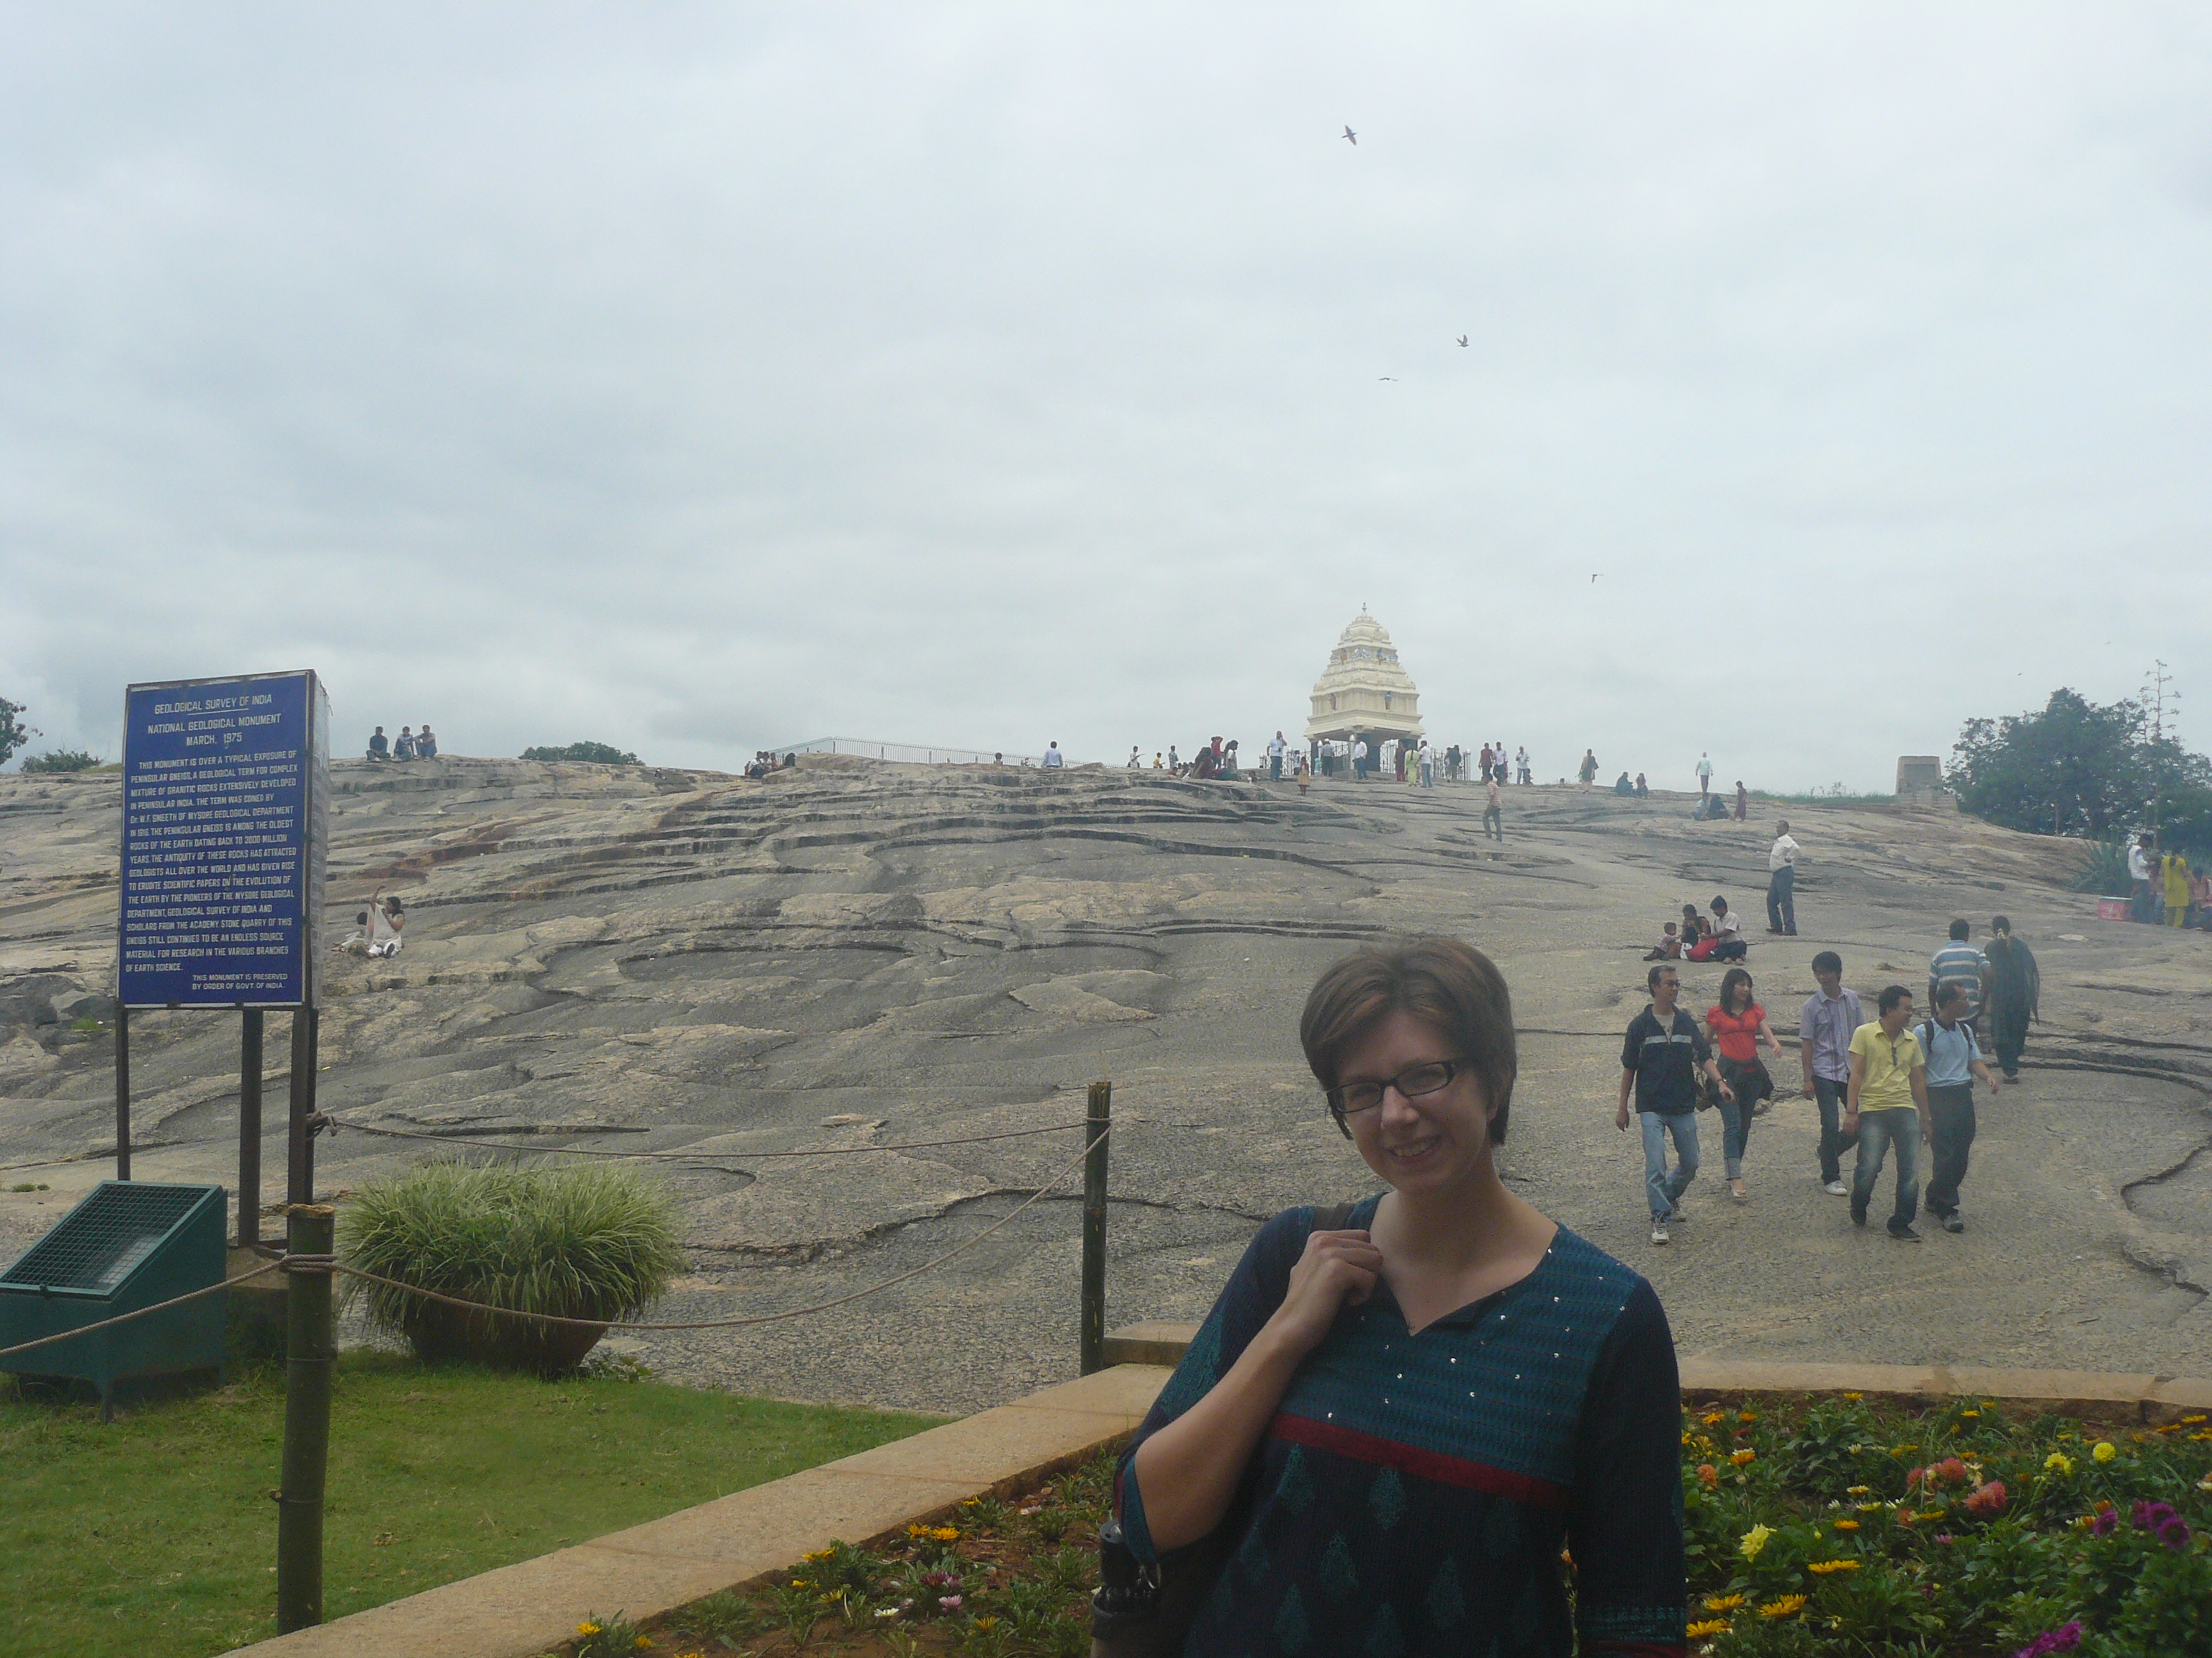
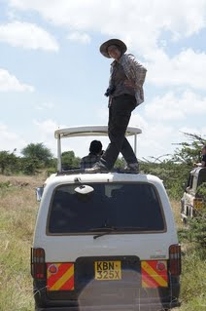
Other cool experiences in grad school
Travel to Bangalore India, for research
1 month in Kenya, living at a remote ecological research center
Lots of travel to conferences….

Slide 9
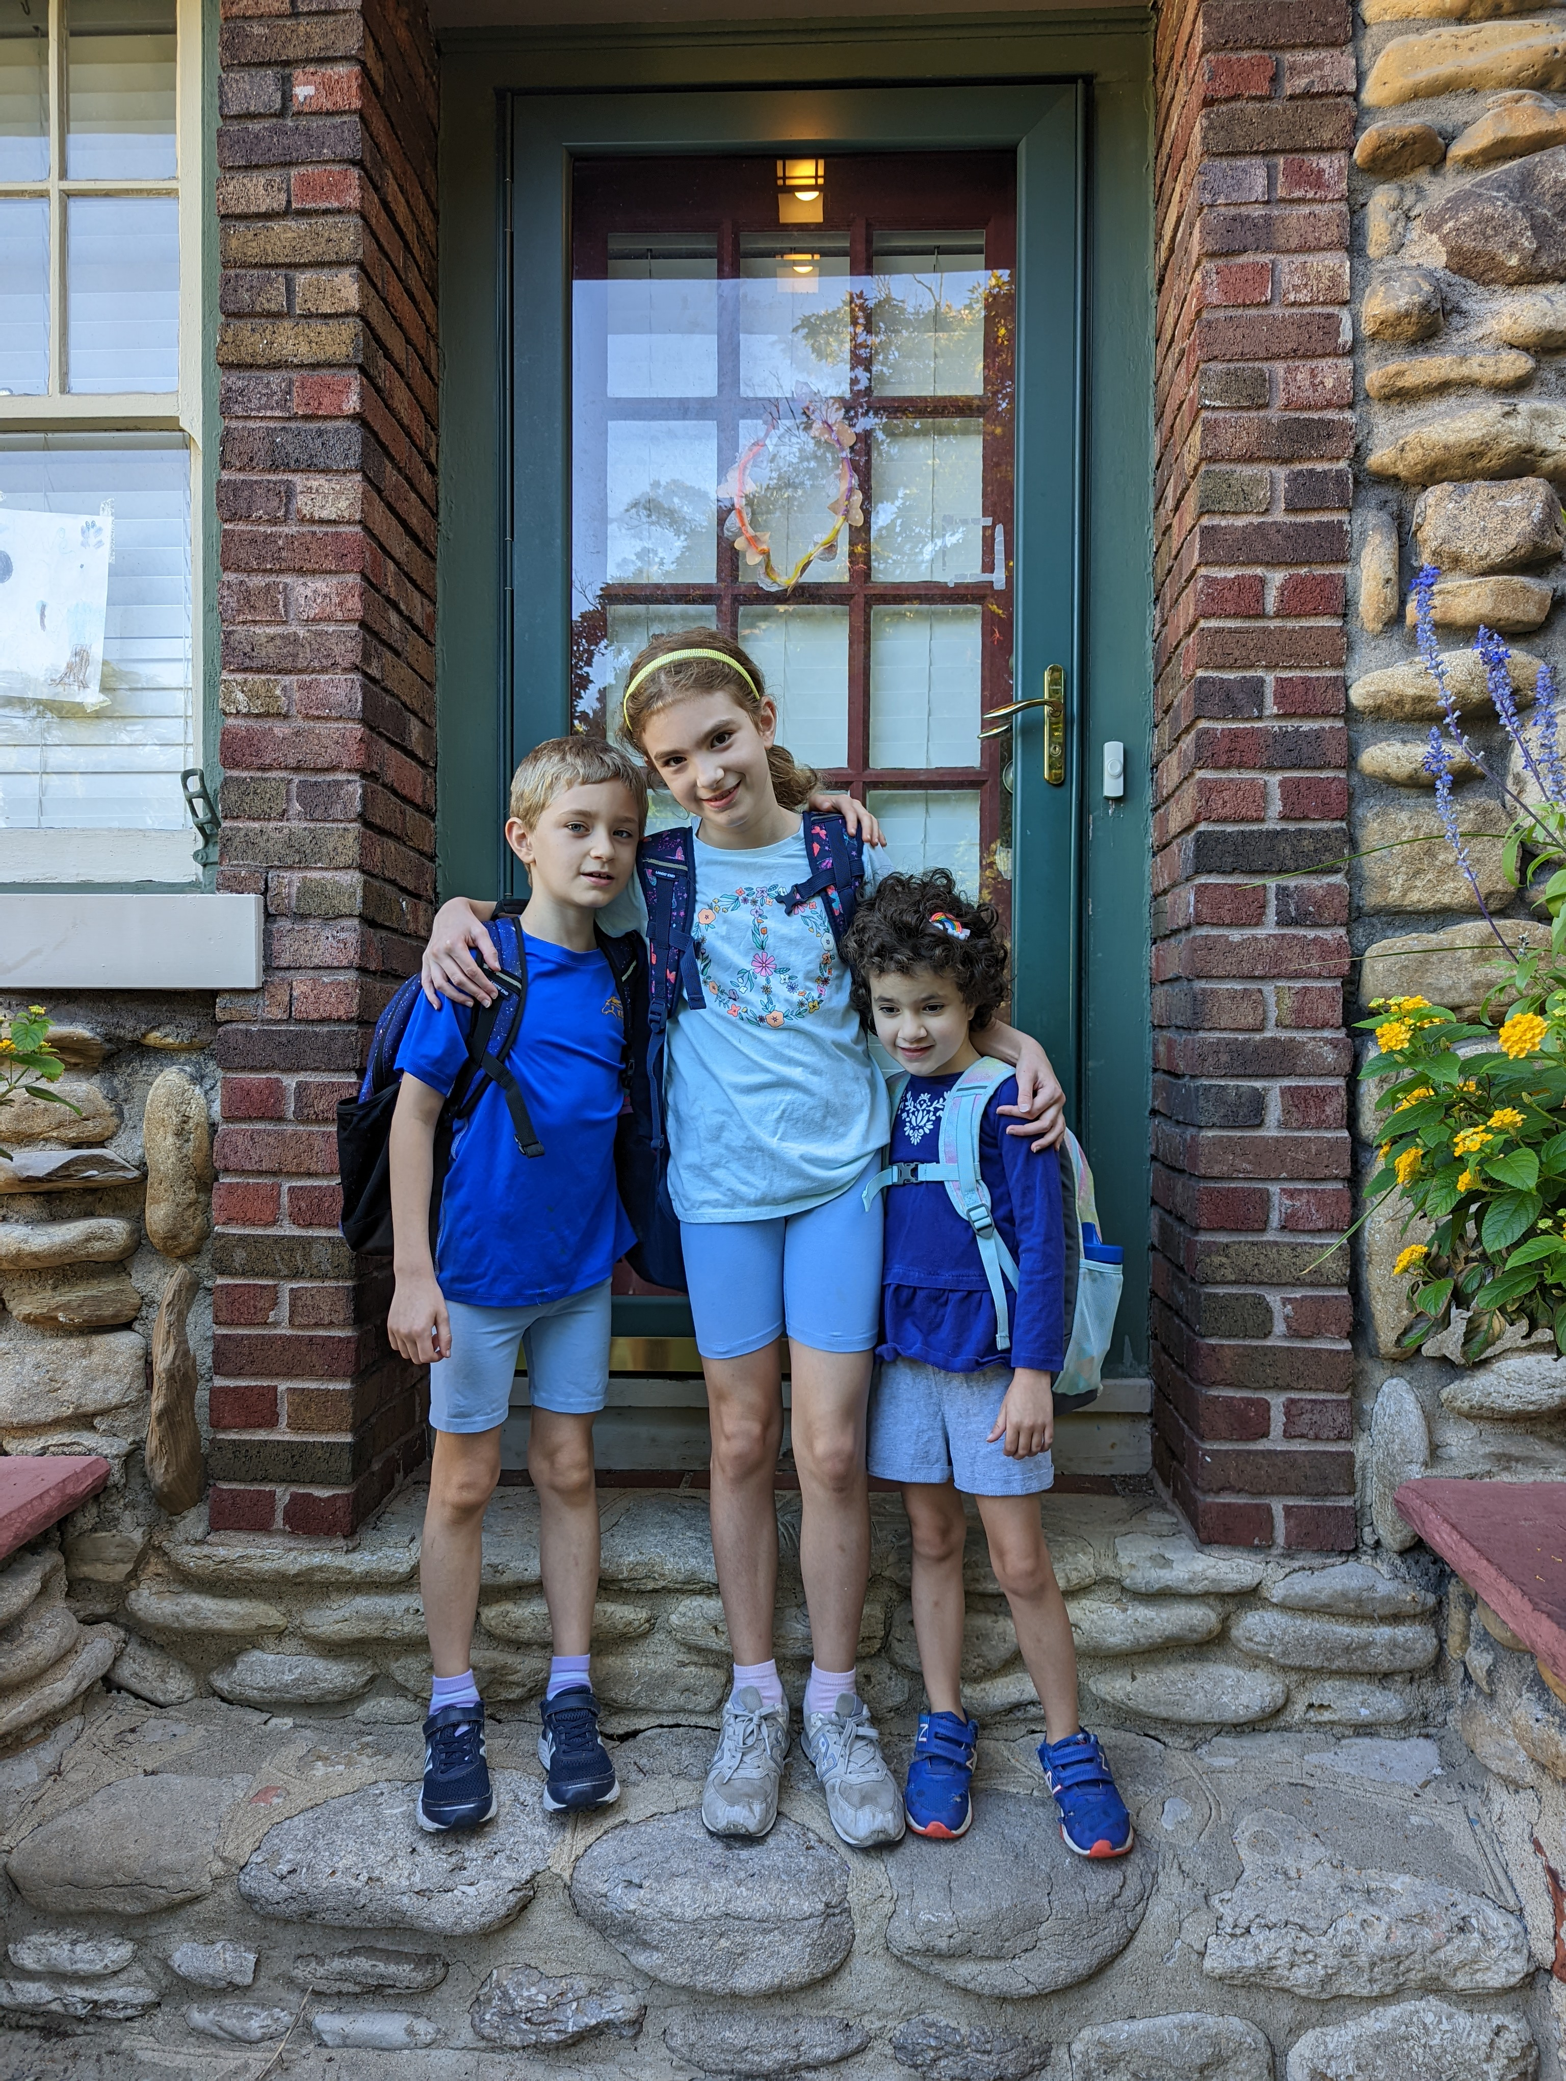
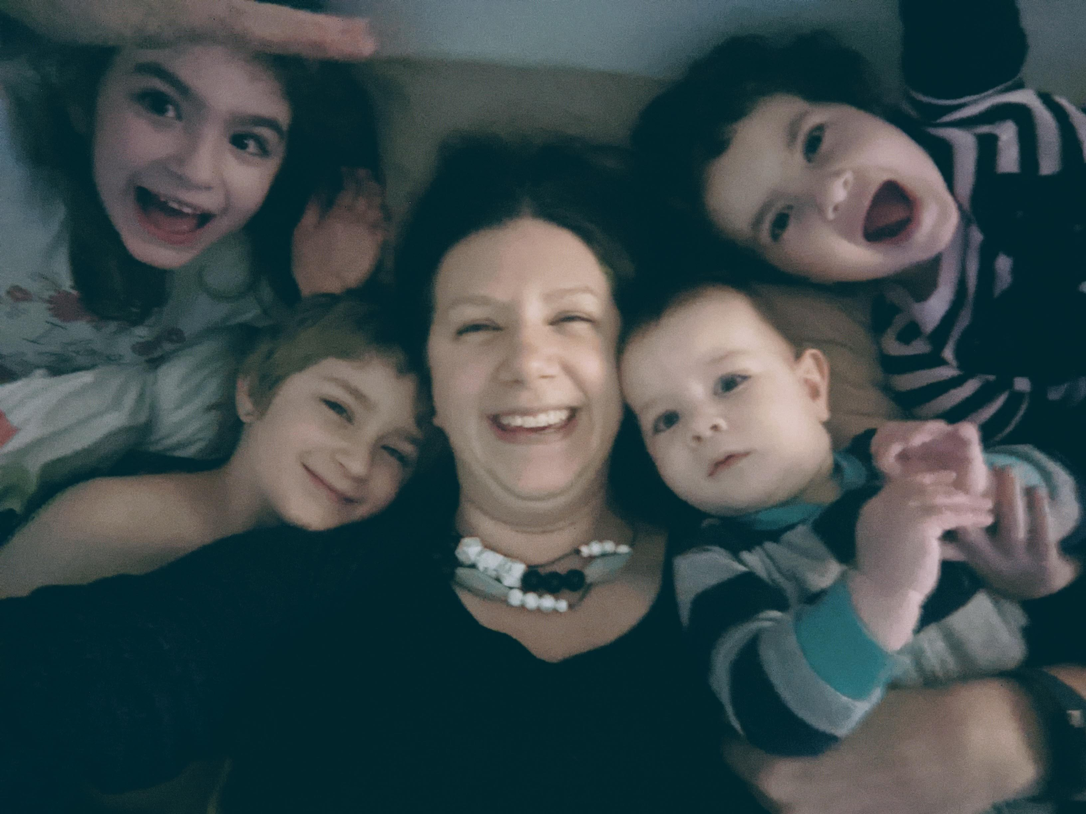
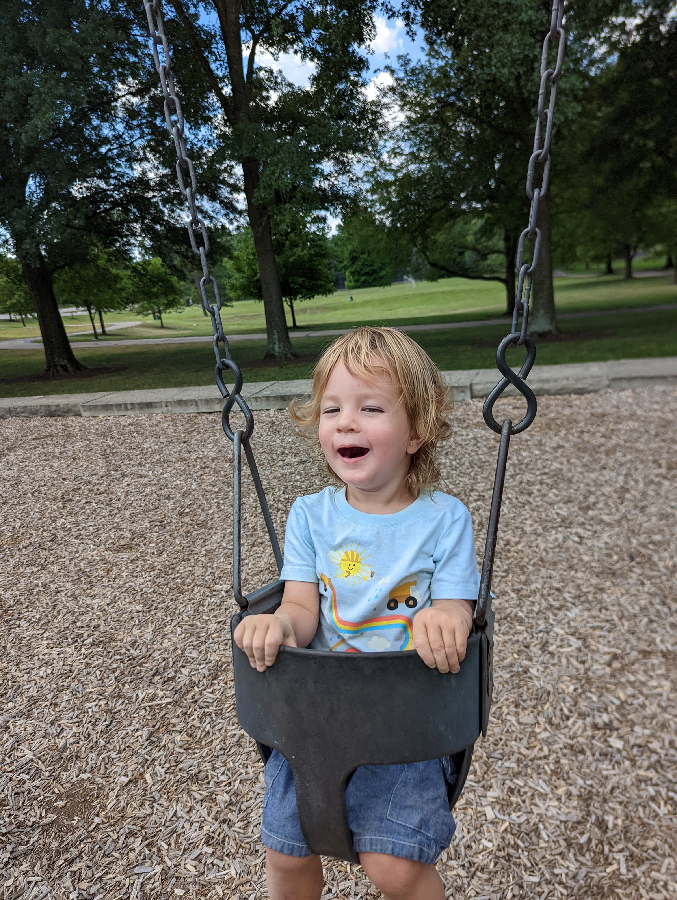
Outside of work

Slide 10
About this course

Slide 11
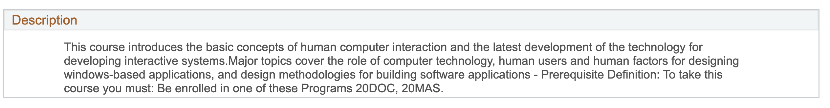
What is this course about?

Slide 12
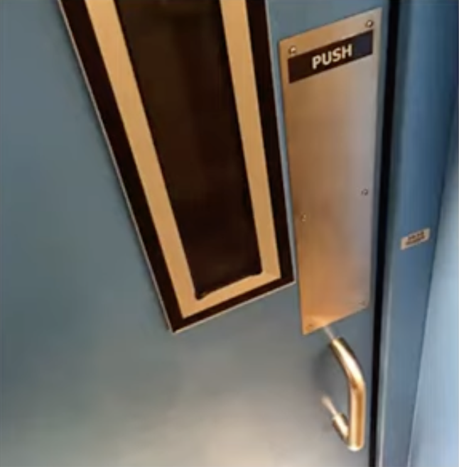
What is this course about-----> Good design
Look at this picture
Does anything seem wrong?
Notes:
Ok, let’s take a look at this picture and pause for a moment. What doesn’t seem right? If it has a handle, what do we want to do? Pull the door. That’s what handles are for. So, why is there a sign? The sign is there to correct a bad design.

Slide 13
What is this course about- ----> Good design
If it needs a sign, it’s probably bad design
Don Norman, Design of Everyday Things
Notes:
There is a great saying from a classic writer in the field of design and interface design, Don Norman, who says ‘it if needs a sign, it is probably bad design.’ Now, this doesn’t mean that we never use signs, but perhaps your sign is redundant to communicating the operation of something, but it shouldn’t be contradictory

Slide 14
What this course is about -------->Good design
What makes a good design? What are some principals of good design?
What practices will help us arrive at good designs?

Slide 15
What is this course about -------> People
Human-centered design of the interfaces between people and computing systems
Humans
Computers

Slide 16
What this course is about -------------> UI+CS
How can we think about interactive interfaces as computer scientists?
How can we enable engineers to create interactive interfaces, visual interfaces, interfaces for different devices….

Slide 17
What is this class about
Understanding the principles of ”good” design’
Understanding people
How people use computers, devices, interfaces
How people perceive, think and behave
What people need to do with an interface- their goals and tasks
Employing practices to arrive at “good” designs
Sketching
Human-centered design methods
Prototyping
Evaluations
Technical understanding/skills (web) to implement these designs.

Slide 18
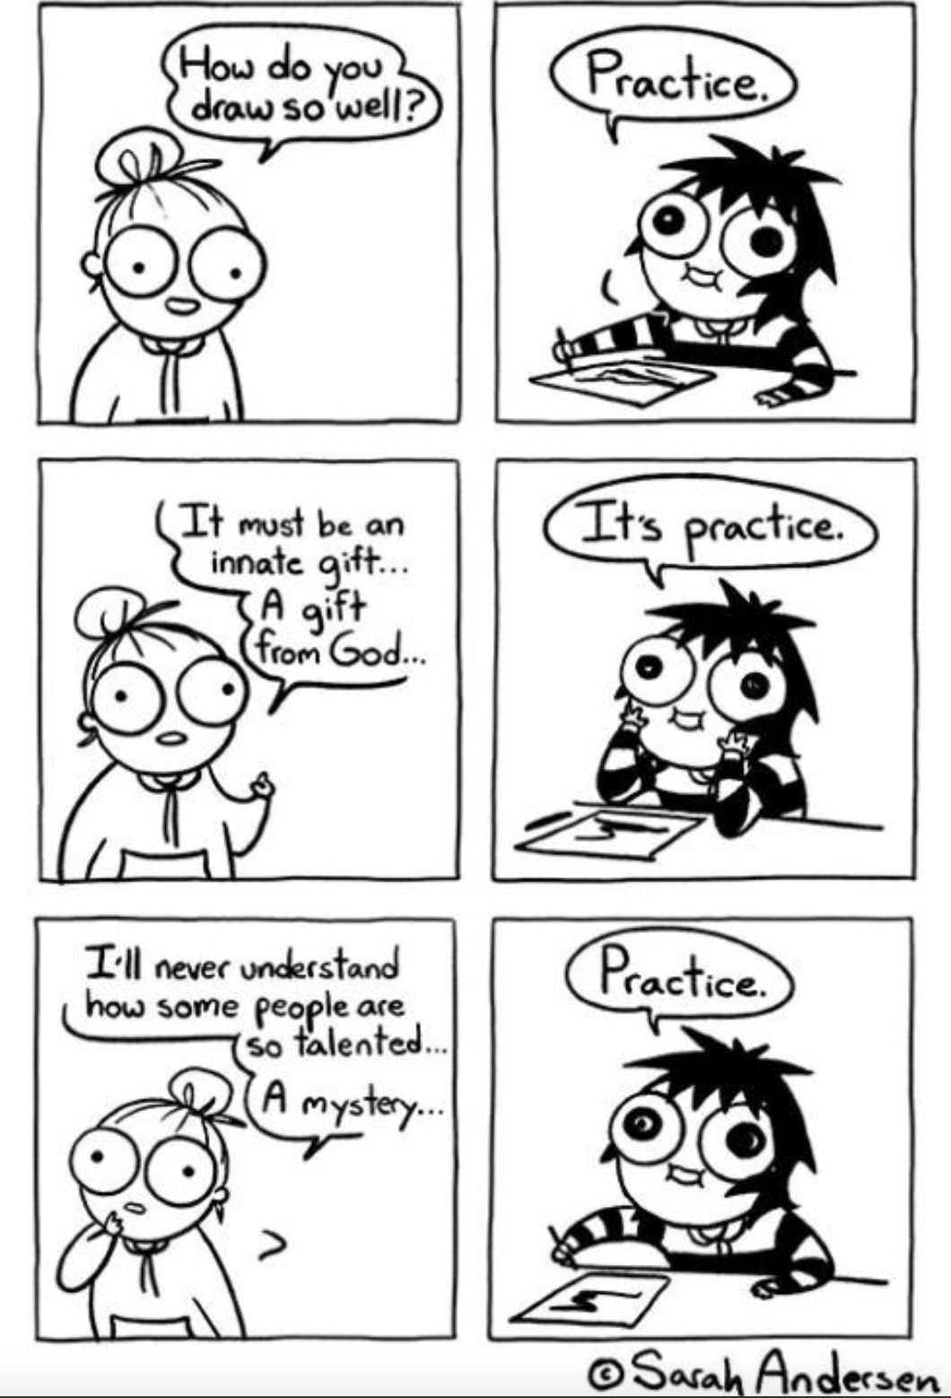
Course philosophy
The best way to learn, is to practice
I teach portfolio style courses:
Most of the evaluated work is in several (usually 3) substantial projects
Solo work and group work
Projects interesting/complex/realistic
You will do a mix of:
Designing
Implementation
Communicating your work online and in a presentation

Slide 19
What will your portfolio look like?
You will create a webpage to showcase your portfolio
Each project will be documented:
Describing the goals
Describing your process
Describing the result
Sketches
Screen-shots
Link to code on github
A video demo

Slide 20
Why build a portfolio?
Reason #1: Jobs
Discussion with a Google resume screener….
My own experience interviewing….

Slide 21
Why build a portfolio?
Reason #1: Jobs
Discussion with a Google resume screener….
My own experience interviewing….
Reason #2: Deeper than a grade
Grades only convey so much….

Slide 22
Why build a portfolio?
Reason #1: Jobs
Discussion with a Google resume screener….
My own experience interviewing….
Reason #2: Deeper than a grade
Grades only convey so much….
Reason #3: Empowerment
For me, CS is about being empowered to create things + help people
Let’s put that into practice NOW

Slide 23
Why build a portfolio?
Reason #1: Jobs
Discussion with a Google resume screener….
My own experience interviewing….
Reason #2: Deeper than a grade
Grades only convey so much….
Reason #3: Empowerment
For me, CS is about being empowered to create things + help people
Let’s put that into practice NOW
Reason #4: Fun

Slide 24
Some evidence that this is a good way to learn….

Slide 25

Learning strategies
Lecture
Reading
Audio-visual
Demonstration
Discussion Group
Practice by Doing
Teaching Others
There are different ways of communicating and processing information.
Which ones “work best” in terms of retaining information or skills?
Which will help you learn the most?

Slide 26
Learning strategies
Lecture
Reading
Audio-visual
Demonstration
Discussion Group
Practice by Doing
Teaching Others
There are different ways of communicating and processing information.
Which ones “work best” in terms of retaining information or skills?
High retention learning strategies!

Slide 27
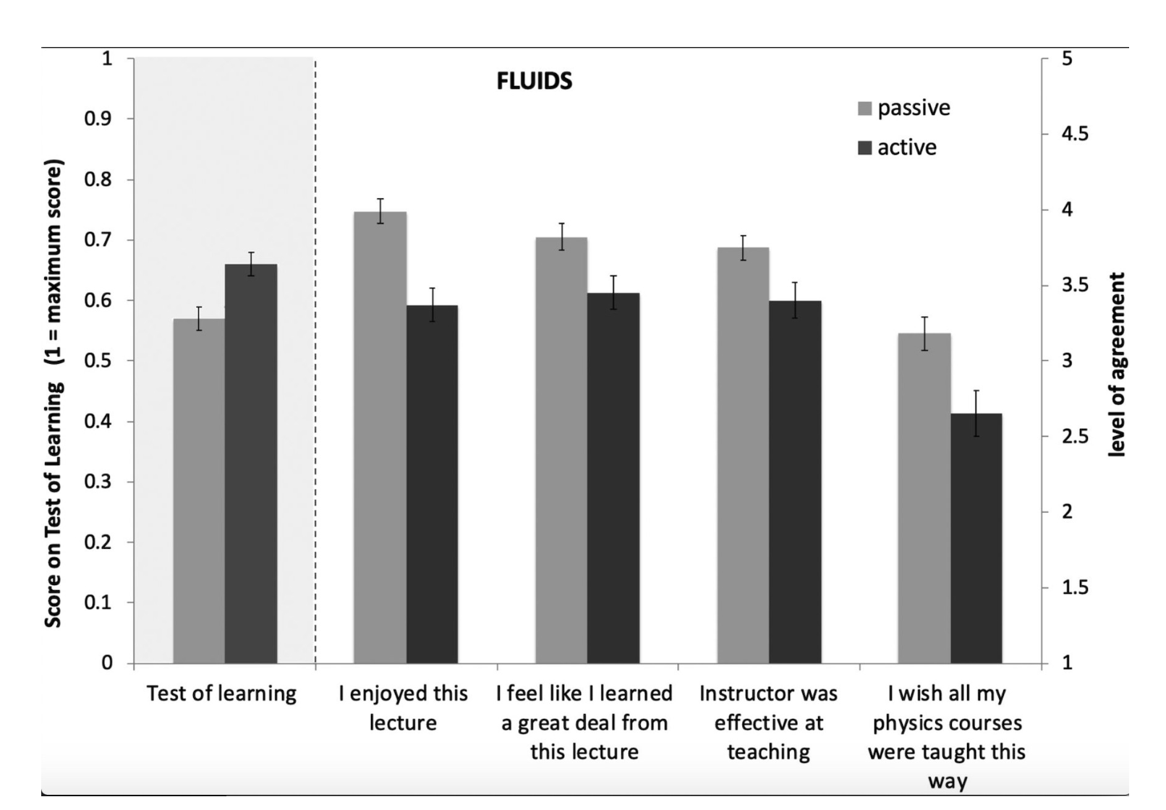
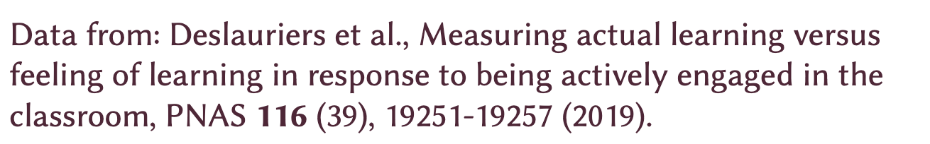
I’m going to try to do lots of active work in class
But students think they learn more from lectures
And they enjoy lecture
more - less effort?
They rank the instructor
as more effective in lecture course
But… I want you to learn so… active learning it is!
Students learn more
with active teaching

Slide 28
Project schedule- FAST!
Project 1
Out: Week 2
Due: Week 6
Project 2
Out: Week 7
Due: Week 10
Project 3
Out: Week 11
Due: Week 15
Note-need to stick to the schedule
Notes:
In order to do those 3 projects, we need to stick to a schedule

Slide 29
TAKE NOTE
These projects may take
A
LOT
OF
TIME!!
It takes time to create user interfaces with thoughtful designs.
It takes time to get something working- bugs will happen
If you are taking lots of implementation heavy courses, think carefully about your schedule!

Slide 30
Take Note
Project lateness policy:
Because we need to keep the schedule, there are CATASTROPHIC penalties for turning in projects late
Just turn it in!!!
Really, I promise, it’ll be ok!
Have things going on?
Please let me know early, so it isn’t a surprise and we can make a plan

Slide 31
How does this translate into grades
Participation and assignments: 15%
Attendance, turning in work done in class, Discord page
2) Projects: 75%
(application + documentation + presentation)
Project 1: 25%
Project 2: 25%
Project 3: 25%
3) Final exam: 10%

Slide 32
Working solo, in groups, collaboration policy
I WANT you to discuss and learn from each other
Discord page: ask questions, give links, code snippets- help each other!
We need online resources, code examples
But, your code (and your group’s code) should be your own
Note your resources (online, peers) in your documentation
First project: Solo
Why: everyone will have a common foundation
Second and third projects: Group project
Why: It is a lot of work!
Good experience with project planning, code sharing with github
Your grade on these projects will be influenced by a peer/self assessment

Slide 33
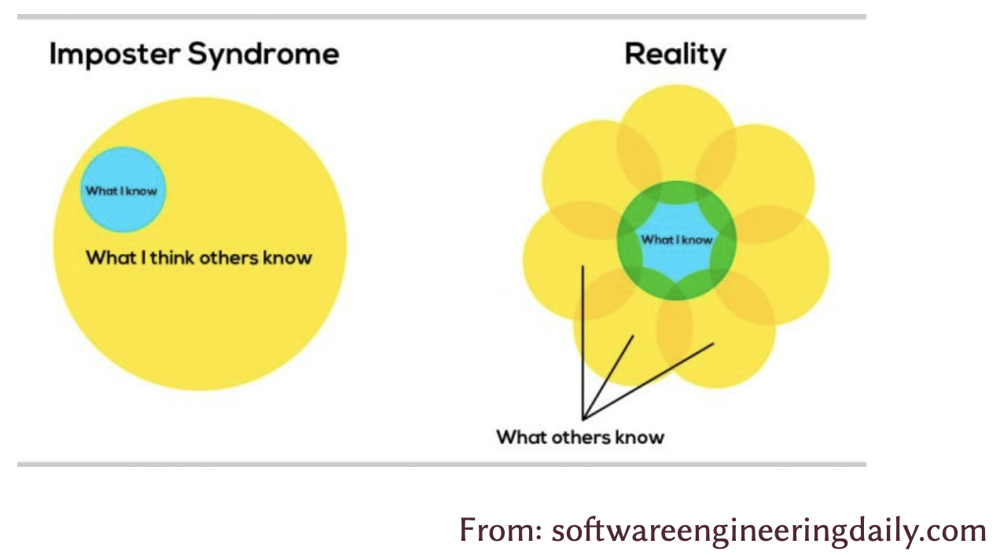
Let’s learn from each other! Remember- we are all learning

Slide 34
Not a web dev course… but
We will cover some web development
First time teaching this course: want to evaluate how we are learning, as we go
Definitely: Html, css, javascript
Possibly: React for project 2
Possibly: Node.js, MongoDB for project 3

Slide 35
Topics
Usability
Learnability
Efficiency
Safety/Errors
Interaction
Graphical presentation- layout, composition, color
Sketching
Storyboarding
Prototyping
Accessibility

Slide 36
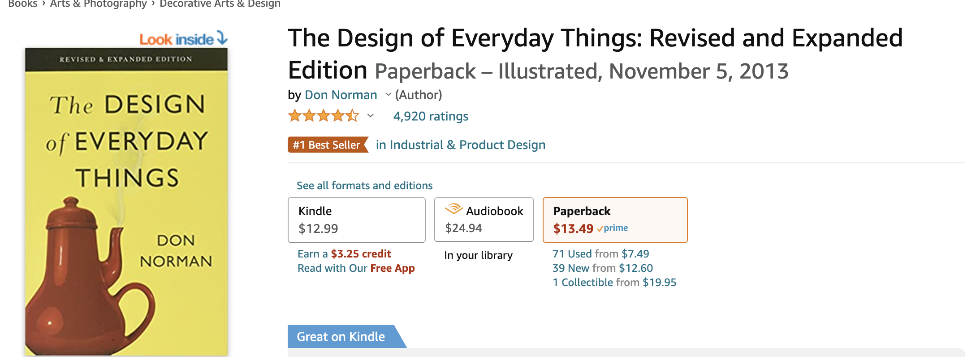
Recommended books
I am not requiring a textbook this year…
But you should all go read Don Norman’s Design of Everyday Things
It is excellent
It is a light read
It is inexpensive

Slide 37
Readings
I will post any assigned readings to Canvas

Slide 38
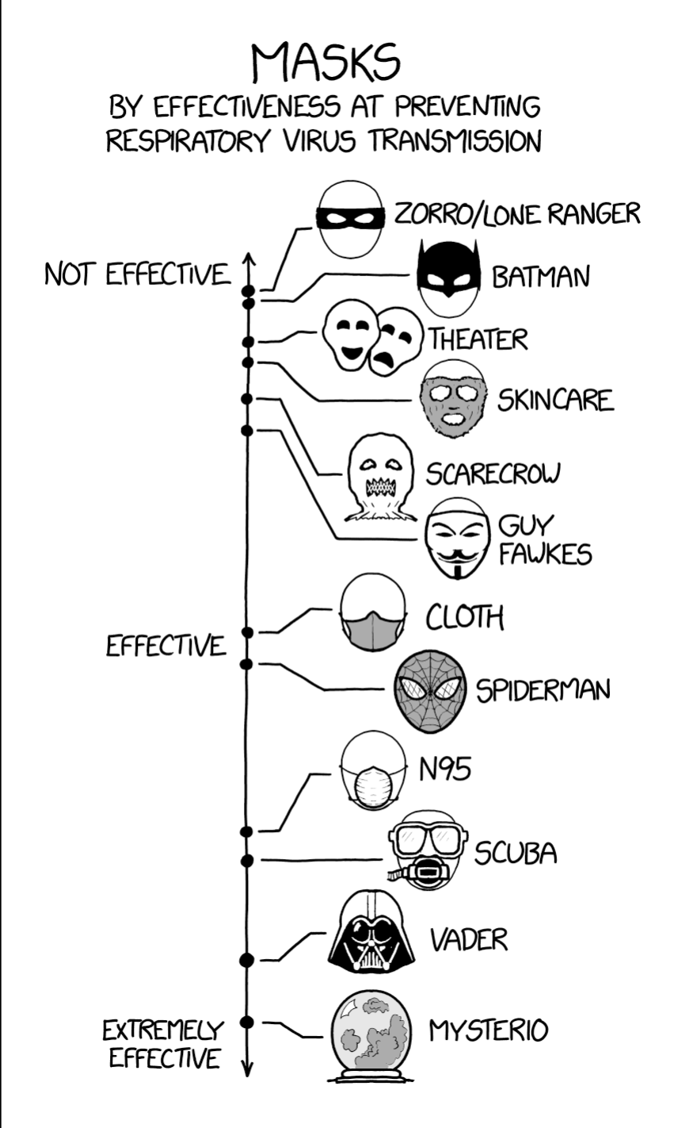
Covid safety
Class is better in person- please come to class!
Feel free to wear a mask
If you are sick- you can join via Zoom
But email me first so I make sure you are able to connect
xkcd

Slide 39
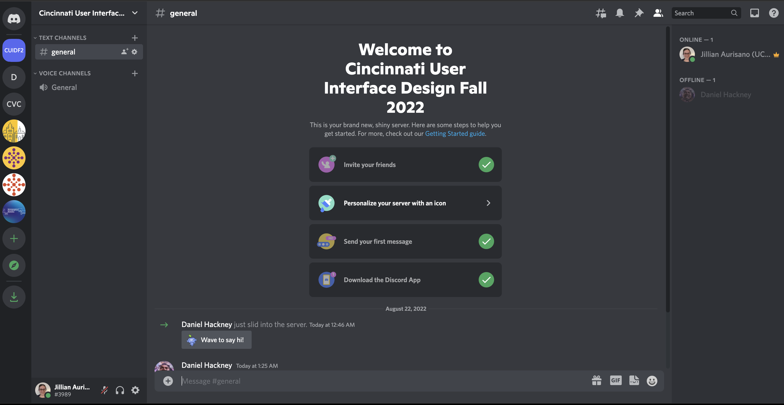
Canvas, Discord
Discord - communication and collaboration
Feel free to PM me on Discord
I’ll set up Discord channels for projects, other discussions
I’ll post content on Canvas

Slide 40
First assignment
Posted to canvas
Due next Monday midnight
Create a webpage for your portfolio
Create a github account
Fill out the book of faces
Sign on to Discord, update your nickname to your real name for this channel
Google forms survey on experiences with UI/web dev

Slide 41
Design
Let’s talk about example designs
These can be designs of interfaces, apps, devices, environments…

Slide 42
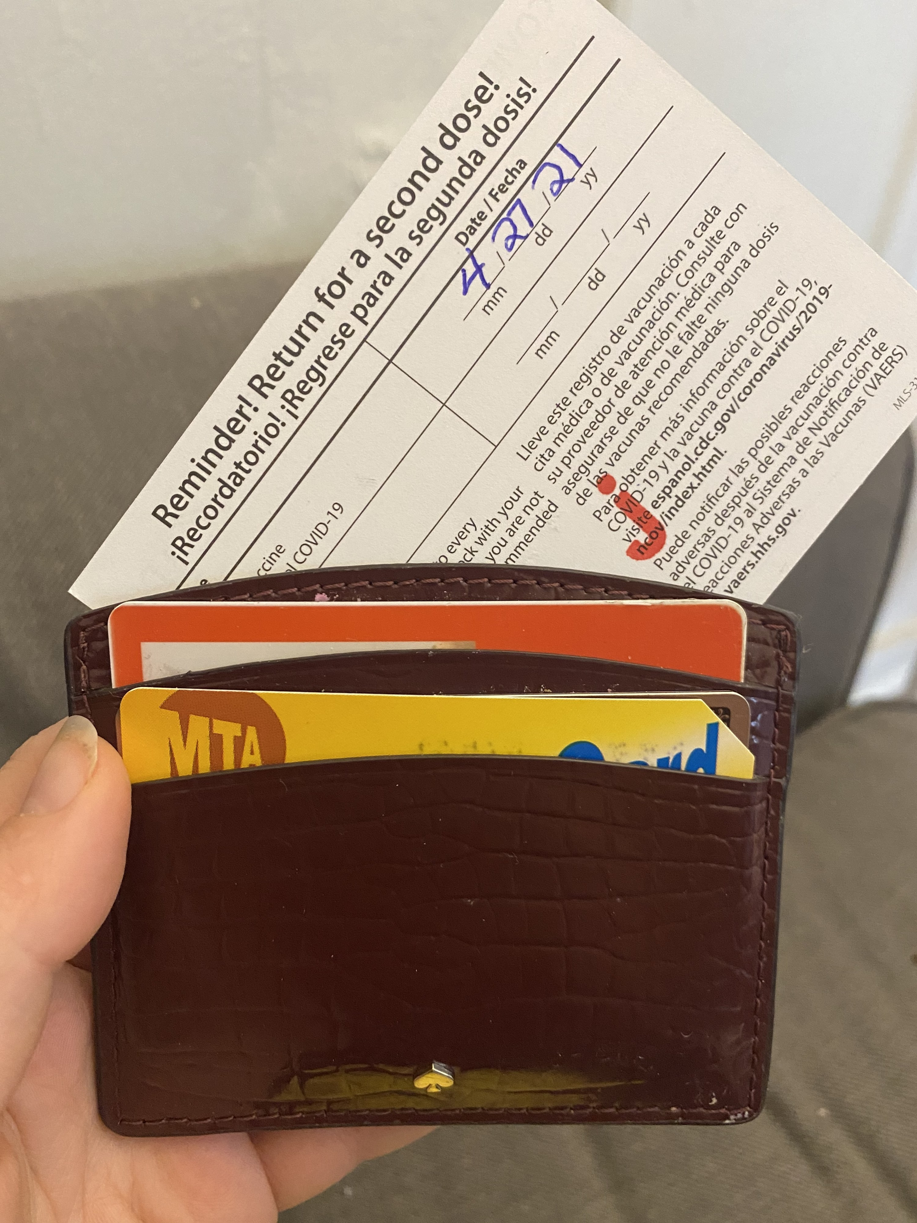
I’ll go first

Slide 43
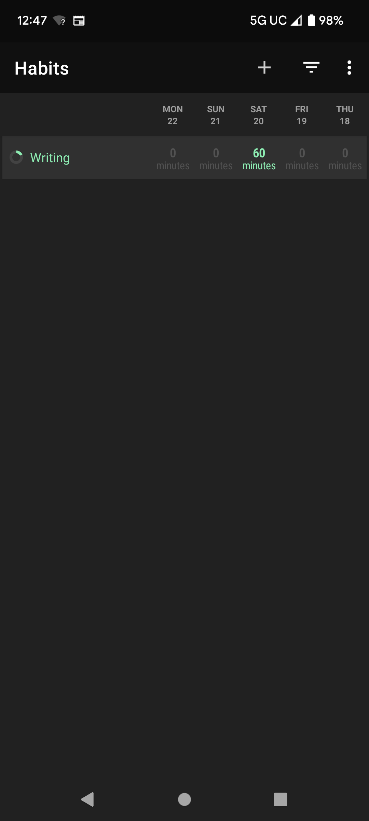
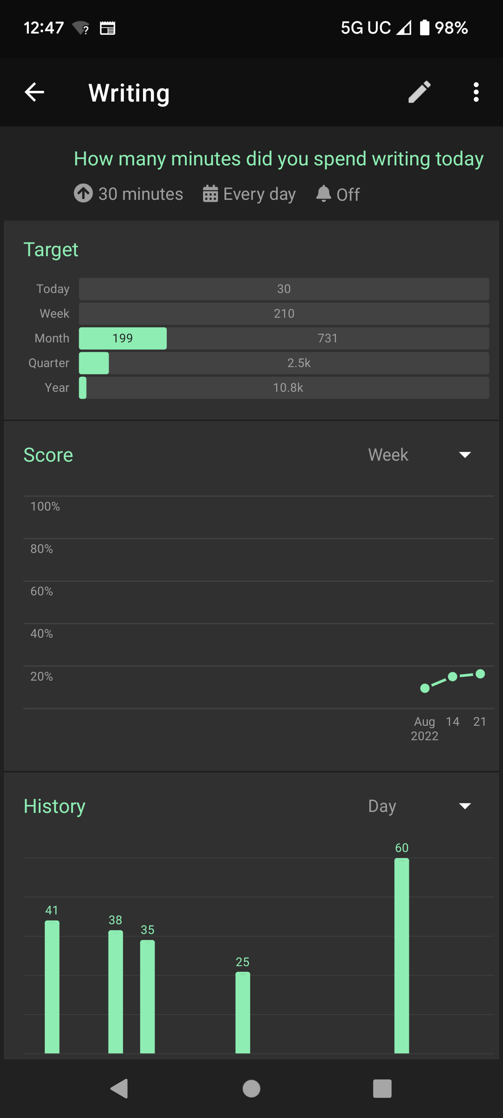
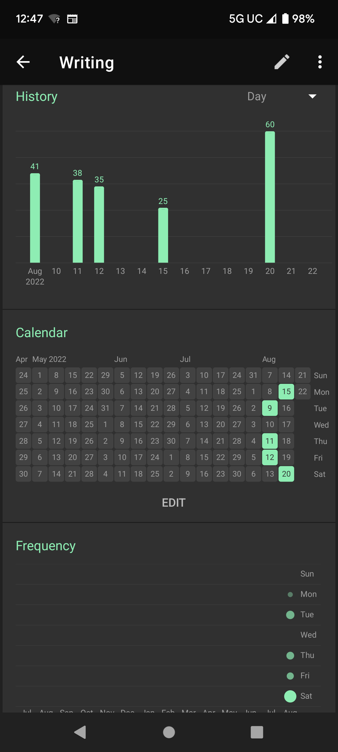
Habit tracking app

